Slide 1
Hovercraft VDP 2
Group 13
Paul Longe
Bradley Blocksidge
Keqi Shu
Divine Abraham
Xiang Zhang
Alexandros Iakovos Agrafiotis

Slide 2
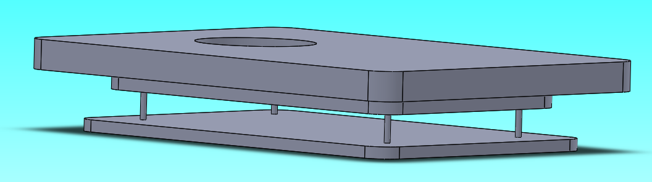
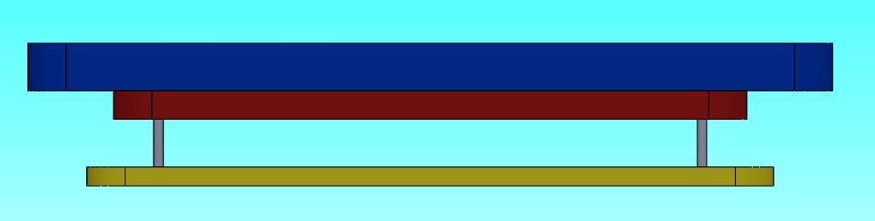
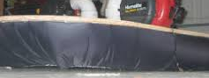
Body and Skirt – Final Design
Bradley Blocksidge – Chassis Engineer
Body
Completed Chassis
Shape
The shaped body will be roughly 418 x 295mm in size, allowing for the thickness of the skirt around each edge.
It will be a rounded rectangle shape.
Reinforcement layer
This layer will attached to the bottom of the hovercraft providing support to the structure. This layer has no set size or shape.
Momentum Curtain
This final layer increases the velocity of the air under the hovercraft therefore increasing the pressure giving it more lift. 400 x 280mm in size, almost as large as the shaped layer.
Chassis Layers
Shaped Top Layer
Reinforcement Layer
Momentum Curtain
Skirt
Wall Skirt
A wall skirt design will be used instead of a finger skirt or bag skirt.
+Less material- Lighter, cheaper. +Simple design-Less time consuming.
- There potentially could be air leakage when going over obstacles.

Slide 3
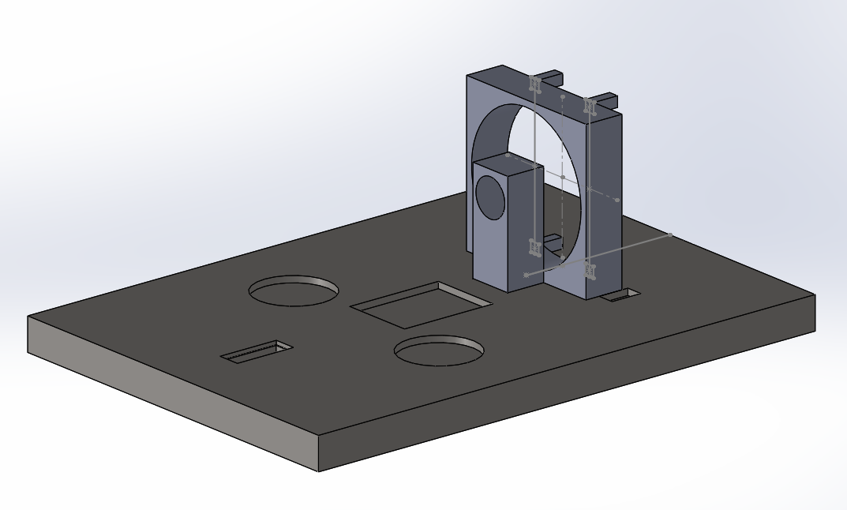
Payload – Final Design
XIANG ZHANG- Payload Engineer
The load areas are placed symmetrically about the center line of the hovercraft.
Grooves are provided for the lift fan, load, servo, motor holder and battery to be fixed to them.
All of the extruded cut should be larger than the actual components to fix them.
Servo is on one side of the propulsion fan.
Four support sticks will be placed behind the propulsion fan to fix the rudders.
Propulsion fan case
Support stick
Battery area
motor holder
Load area
servo area
Lift fan area
CALCULATIONS
All of the apparatus are vertically symmetrical about the centre line except for the servo.
Horizontally symmetric---left hand side moment=right hand side moment
(150+11+51)*(87.5+15)=33*102.5+200*x+200*x(x=position of the load)
X=46mm
The load area should be placed 46mm away from the centre point to balance the hovercraft.
Name | Length x width x thickness/mm | Weight/g
Payload area | 415 x 292 x 25 | 390(without load)
Battery | 74 x 55 x 20 | 145
Lift | 75 x 75 x 15.4 | 33
Propulsion | 100 x 100 x 25 | 150
servo | 23 x 12 x 27 | 11
Load | 57 x 57 x 11.5 | 200
motor | 27.7 x 27.7 x 47 | 51

Slide 4
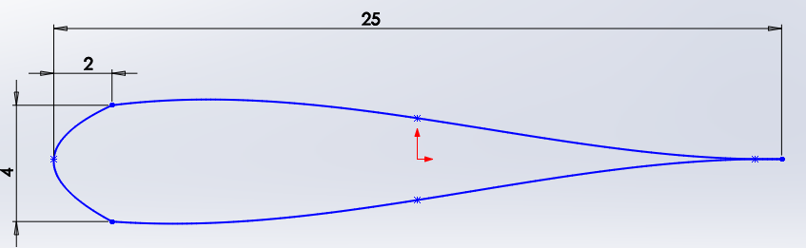
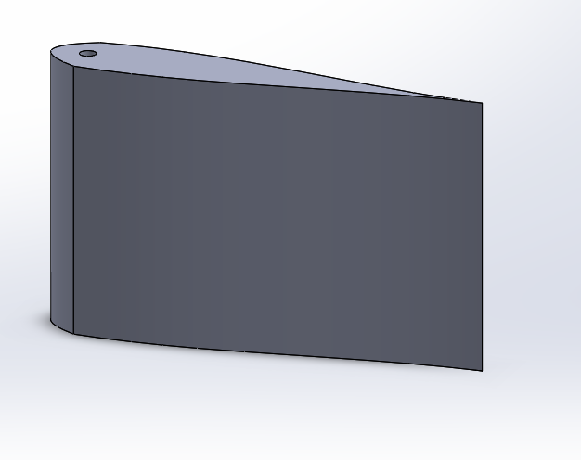
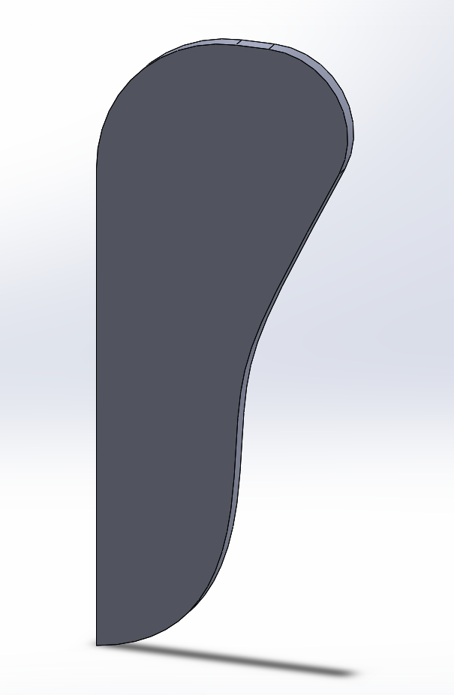
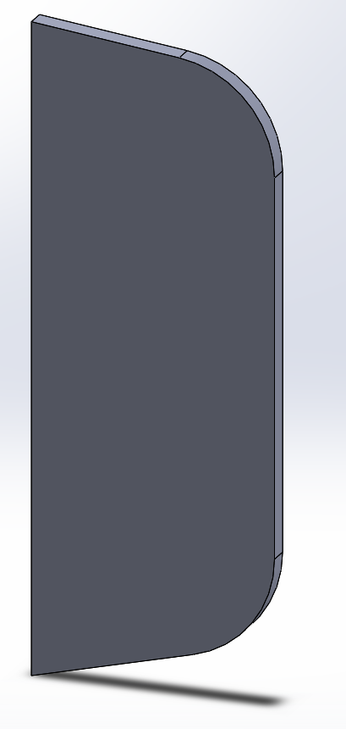
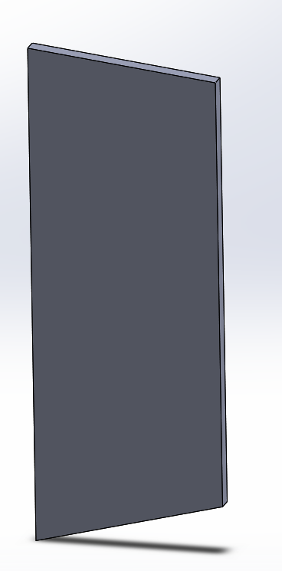

Turning – Final Design
Paul Longe – Integration Engineer
In order to turn the hovercraft, the use of rudders was selected as it was the option that best fulfilled selection criteria.
Rudders can be made with a cheap material, and are easy to manufacture.
Having more than one rudder increases the amount of air that can be redirected, the rudders needs to have a synchronized movement system. A simple linkage was chosen over a more complex 4 bar system.
Radius of turn needs to be minimized, this is done by redirecting more air flow through a symmetrical airfoil design to minimize air drag. And through having two rudders rather than just one.
The rudder is secured through the use of pins attached to the cowling. The location of the pin is in the thickest part of the rudder as it will bear high amounts of load.
There is a 4mm tolerance between the height of the rudder and the parts to secure it
Although it is difficult to calculate how much airflow the rudders are able to redirected, I have done calculations to show how much rotation can be achieved over a time period with the rudders set to different angles.
The table displays total angle turned over a time period at different angles of the rudder. It shows a 10° increase in rudder angle results in a 8.5% increase in turn for all times
Rudder angle 60°
Time (s) | Angle turned(°)
0.1 | 11.58
0.2 | 46.31
0.3 | 104.20
0.4 | 185.25
Rudder angle 70°
Time (s) | Angle turned(°)
0.1 | 12.56
0.2 | 50.25
0.3 | 113.06
0.4 | 201.00

Slide 5
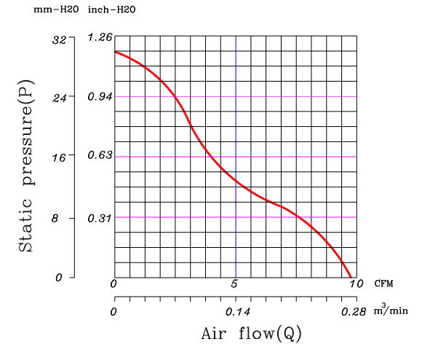
Fans-Materials & Total Cost
Alexandros Iakovos Agrafiotis – Design Engineer
Axial Fan, Centrifugal Fan & Material Selection
Basic material is going to be the Craft foam Blue because it is thick (25mm) strong enough for not breaking with the load and it is very light. Also, easy to change the shape. Cost is £12/ m² .
A centrifugal fan is going to be used for the lift as it needs low power to produce high pressure.
An axial fan is going to be used for the thrust of the hovercraft as it produces high air flow and it needs low power in order to work efficiently.
The total cost of the hovercraft is going to be around £130
Diagram 1- Static Pressure versus Air flow
Calculations Pressure needed to lift a hovercraft for A3 size around 2kg is : P= F/A = 162.81 Pa
Where F= m x g =19.62 & A= size A3 – hole of fan = 0.120505 m² In order to produce the pressure needed we will need low air flow under 2.29 m/s. That means the total pressure is the Static Pressure and the Dynamic Pressure: P_{t} = P_{s} + P_{d} = 173.73 + 3.21= 176.97 Pa Where P_{d} = ½ x ρ x v² = 3.21 Pa
We are not able to calculate the air flow and thrust from the Axial Fan as it is going to be with custom blades and a motor that produces 7800 rpm.
Centrifugal Fan (Lift) Specifications
Rated Voltage | 12V | 7V Min.
Rated Current | 0.46 Amp | 0.55 Amp Max.
Rated Power | 5.52 W | At 12V
Speed | 4500RPM | ±10%
Dimensions | L × W × H (mm) | 75 × 75 × 15.4
Weight | 55 grams | -

Slide 6
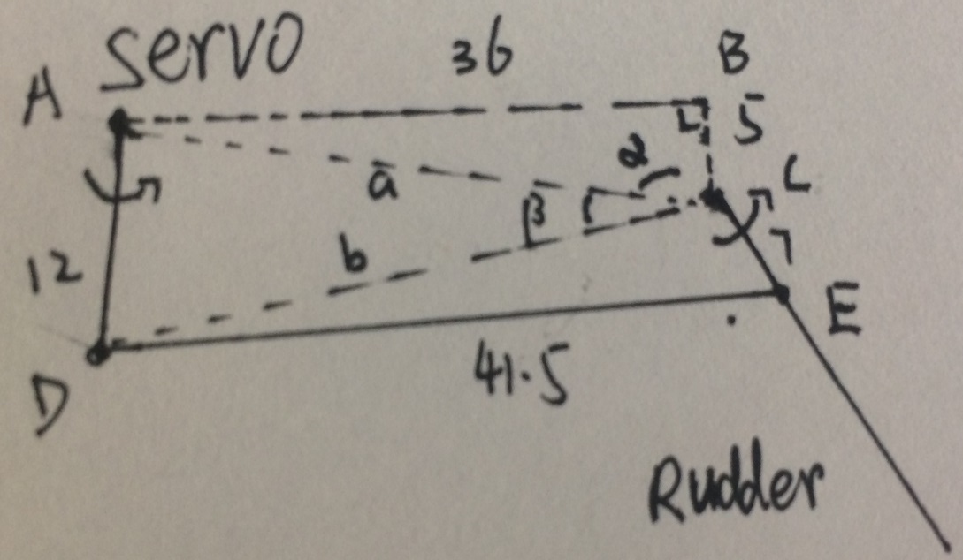
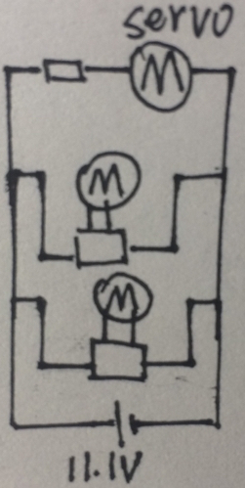
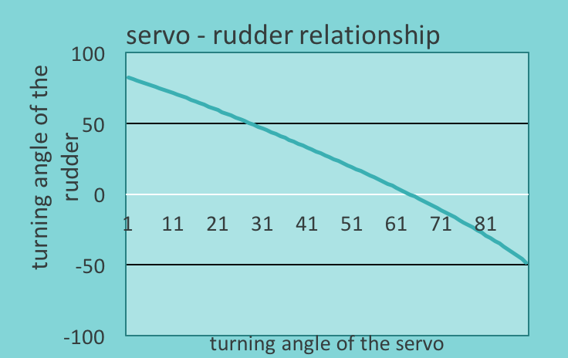
Powertrain – Final Design
Keqi Shu- Powertrain Engineer
Motor & Circuit
Study the battery & motor controller
Evaluate the torque and the turning speed under load condition.
Parallel circuit.
Power the servo by series connect a resistor.(balance the voltage)
Set up the safety ratio to 1.2.
Transmission Structure
Decided to use Linkage mechanism.
Use the most severe conditions to decided the length of links.
Use excel to have the turning angle relationship.
Change the links length and find the best solution.
Errors of servo in turning angle(strict to 100)
Turning angle difference in two sides
 | Servo | resistor | Lift | thrust | Needed (*1.2 ) | provid
Voltage(V) | 6- 7.4 | 3.7-5.1 | 12 | 6-15 |  | 11.1
Engery (Wh) | 0.84 | 0.9 | 5.52 | 8.54 | 18.96 | 28.8
Weight (g) | 11 | 1 | 55 | 58.8 | 125.8
torque | 20Ncm |  |  | 58.8gcm
Price(£) | 5.45 | 1 | 10.6 | 4.39 | 25.73
Calculations & Proves
P=IV, current and voltage of servo and resistor are nearly the same .
DF =3(n -1)-2n' =1
The Law of Cosines
a²=b²+c²-2bccosA etc
The Law of Sines
sinA / a = sinB / b = sinC/c

Slide 7
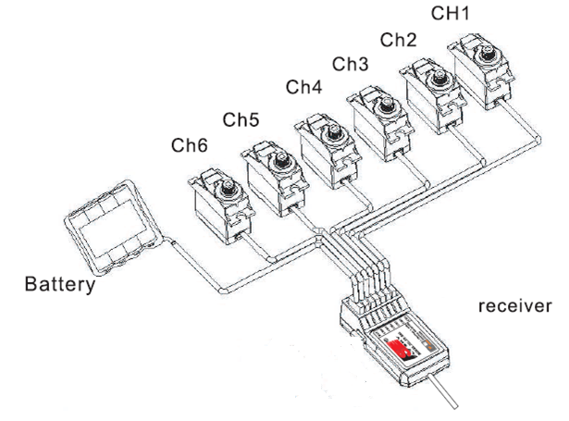
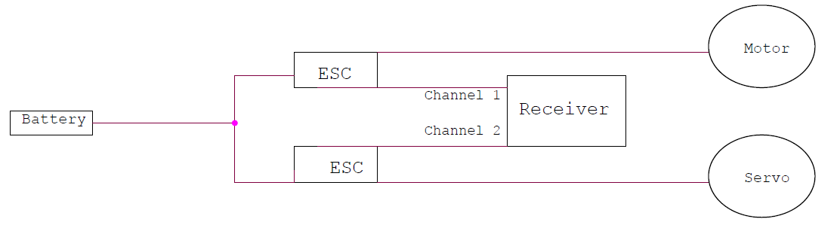
Circuits & ESC’s – Final Design
Divine Abraham - Electrical & Control Systems Engineer
What am I supposed to Control?
Lift
Speed
Direction
How Will I do it?
Battery connected to the ESC and ESC to Receiver.
Each channel of the receiver will be connected to an ESC.
ESC will be connected to the motors (fan) or a servo (rudder) that needs to change with user requirement.

